Slide 1
知识点回顾
车轮定位参数有哪些？各起什么作用？What are the wheel alignment parameters? What role do they play?
主销后倾 Kingpin caster angle 偏转时汽车离心力的地面反力产生回正的稳定力矩
主销内倾 Kingpin inclination angle 车重作用下产生自动回正力矩；通过主销偏置减小转向力矩，使传向操纵轻便；减小车轮对传向盘的冲击。
前轮外倾 Front wheel camber 避免汽车满载时车轮内倾而引起车轮的偏摩；防止轮毂外端的小轴承和紧固螺母承受过大的载荷；和拱形路面配合，提高车辆的安全性；能够提供小量的不足转向。
前轮前束 Toe-in 消除因前轮外倾引起的前轮边滚边滑的现象

Slide 2
知识点回顾
按连接车轮作用分，车桥有哪些类型？What types of axles are there according to effect of connected wheels?
转向桥 Steering axle
驱动桥 Drive axle
转向驱动桥 Steering drive axle
支持桥 Support axle
转向驱动桥的主要组成部件？What are the main components of steering drive axle?
主减速器、差速器、万向节、转向节、主销

Slide 3
第二十二章 悬架
Chapter 22. Suspension

Slide 4
主要内容Content
悬架的组成、功用以及分类；The composition, function and classification of suspension；
常用减振器的结构形式；Structure form of common springs；
常用弹性元件的结构形式；Structure form of common dampers；
非独立悬架；dependent suspension ；
独立悬架；independent suspension ；
多轴汽车的平衡悬架；balanced suspension of multi-axle vehicle；
主动悬架和半主动悬架。active suspension and semi-active suspension.

Slide 5
请看一段视频
讨论：
1）悬架的作用 Function
2）悬架的组成部件 key components

Slide 6


Slide 7
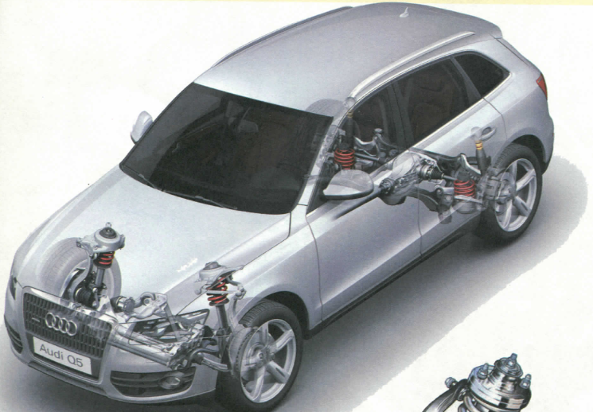
第一节 概述
Section 1. Overview

Slide 8
悬架的功用和组成
Function and Composition of the Suspension System
悬架：车架（或承载式车身）与车桥（或车轮）之间的一切传力连接装置的总称。
Definition: all the force delivering devices between the vehicle frame (or monocoque body) and the vehicle axle ( or wheel) are called suspension.
悬架的功用：把作用于车轮的垂直反力、纵向反力和侧向力以及这些反力引起力矩传递到车架，并使车辆具有良好的乘坐舒适性、平顺性和稳定性.
Function: transmit the vertical force, the longitudinal force , the lateral force as well as the caused torques to the frame , in order to obtain a good ride comfort and stability.

Slide 9
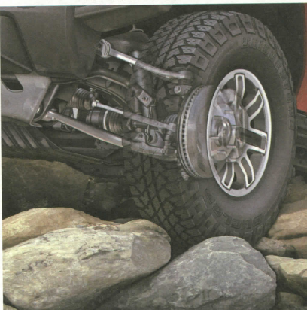
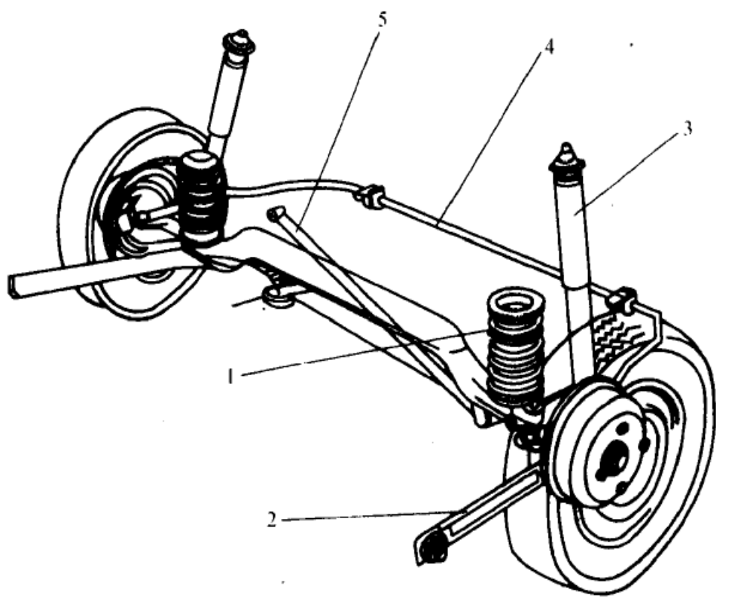
悬架的功用和组成
Function and Composition of the Suspension System
横向推力杆Lateral rod/ Panhard rod
横向稳定杆Stabilizer bar
阻尼元件Dampers
弹性元件Suspension Springs
纵向推力杆Longitudinal rod
悬架的主要部件：汽车悬架一般都由弹性元件、阻尼元件（减振器）、导向机构（纵、横向推力杆）三部分组成。在一些车辆上还要加装横向稳定器。Main components: spring elements, dampers(shock absorber), guide mechanism (longitudinal rod, lateral rod). Some vehicles also equipped with the stabilizer bar.

Slide 10
汽车悬架各组成部分的作用
Function of each components in suspension system
弹性元件:使车架与车桥的连接具有弹性，吸收、缓和路面冲击和振动。Spring elements: to make the connection of the frame and axle having elasticity and the ability of absorbing, buffering road impact and vibration.
阻尼元件:衰减弹性元件的振动，吸收并散发振动能量。Damping elements: attenuate of the vibration of the spring elements, absorb and dissipate vibrational energy.
导向杆系:约束车轮按一定的轨迹运动，承受并传递各方向的力和力矩。Guide arm: holding wheel trajectory, carrying and transmit forces and torques.
横向稳定器:在汽车转向时，减小车身的倾斜和横向角振动。Stabilizer(anti-roll bar): by steering condition, reducing body inclination and lateral angular vibration.

Slide 11
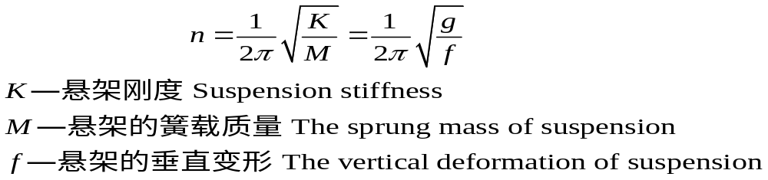
悬架系统的自然振动频率
Natural frequency of the suspension system
汽车自然振动频率是影响汽车平顺性的重要性能指标之一，一般称之为车辆的偏频，其取值目标范围一般在1~1.6Hz之间。Automotive natural vibration frequency is one of important performance indicators that affect the car ride, commonly known as the vehicle yaw natural frequency, its value range of 1 ~ 1.6Hz.
簧载质量：由悬架刚度和悬架弹簧支承的质量。Sprung mass: the mass supported by the suspension stiffness and suspension spring.
汽车自然振动频率由汽车簧载质量和悬架刚度决定。Automotive natural vibration frequency is determined by the vehicle sprung mass and suspension stiffness.

Slide 12
悬架系统的自然振动频率
Natural vibration frequency of suspension system
簧载质量一定，悬架刚度越小，偏频越小，但车轮上下跳动会变大。Definitely sprung mass, the smaller the suspension stiffness, the smaller the yaw natural frequency, but with a larger wheel up and down.
悬架刚度一定，簧载质量越大，偏频越小。Definitely sprung mass, the smaller the suspension stiffness, the smaller the yaw natural frequency, but with a larger wheel up and down.
因为车辆的载荷一直是变化的，因此需要悬架的弹簧具有变刚度特性，以保证车辆在不同的载荷情况下具有相当的行驶平顺性。Because of the changing vehicle load, the suspension spring needs to be with variable stiffness characteristics, to ensure that the vehicle ride comfort quite different load cases.

Slide 13
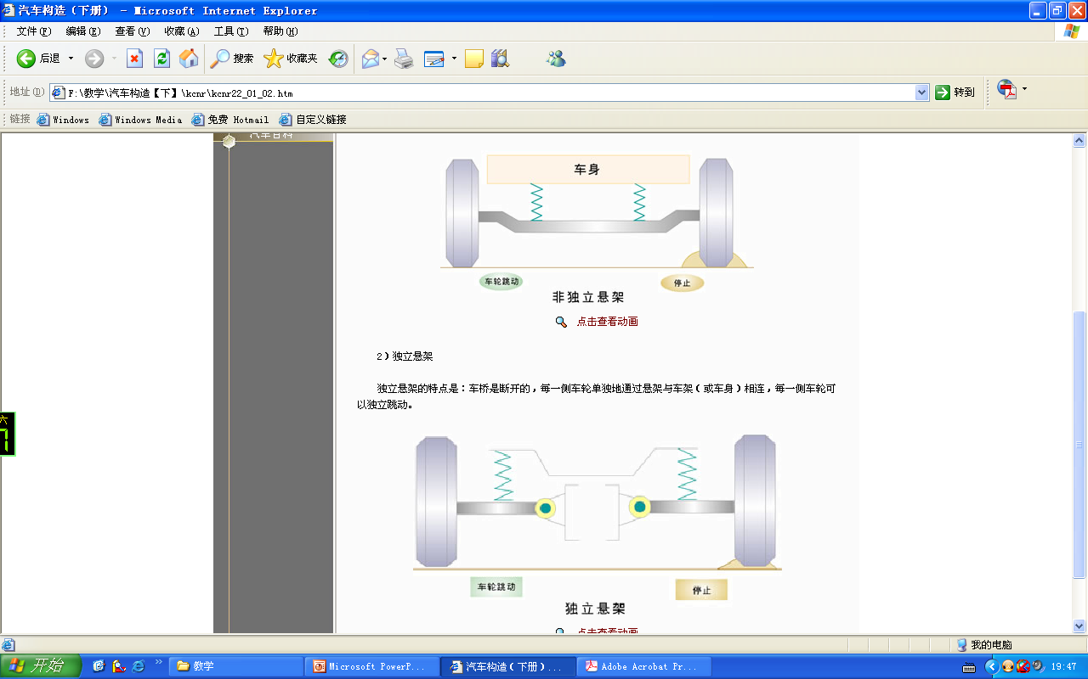
悬架系统的类型
The type of suspension system
按汽车悬架的结构特点分为非独立悬架和独立悬架。Suspension systems can be broadly classified into two subgroups: rigid axle suspension and independent suspensions referring to the ability of opposite wheels to move independently of each other.
特点：两侧车轮通过整体式车桥相连，车桥通过悬架与车架或车身相连。如果行驶中路面不平，一侧车轮被抬高，整体式车桥将迫使另一侧车轮产生运动 。Characteristics: two wheels on both sides are connected with a rigid axle, the rigid axle connected to the frame or body through the suspension. The motion of one wheel affects the motion of the other wheel during single-wheel compression events.
特点是：车桥是断开的，每一侧车轮单独地通过悬架与车架（或车身）相连，每一侧车轮可以独立跳动 。Characteristics: the axle is disconnected, two wheels on both sides connected to the frame (or body) individually through the suspension . Each side of the wheel can be move independently.

Slide 14
悬架系统的类型
The type of suspension system
按悬架的性能是否可控According to the suspension controlled or not
被动悬架
Passive suspension
主动悬架
Active suspensions
半主动悬架
Semi-active suspensions
悬架刚度、阻尼在行驶中不可调整的悬架。The suspension stiffness, suspension damping in motion can not be adjusted .
悬架的刚度、阻尼根据行驶状况不同，可以自动调节的悬架。Suspension stiffness , damping can be adjusted automatically according to the traveling condition.
只有悬架阻尼可以自动调节的悬架。Only a suspension damping of the suspension can be adjusted automatically

Slide 15
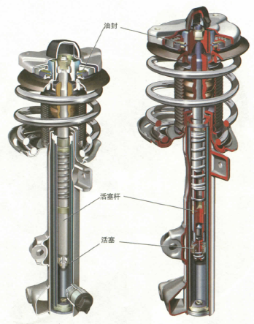
第二节 减振器
Section 2. Shock absorber

Slide 16
汽车减振器的作用和类型
The Functions and Types of Shock Absorber
汽车减振器的作用：通过减振器自身的运动，消耗弹簧变形储存的能量，将其变为热能，并散发到空气中，以衰减弹簧的振动。The role of the automobile shock absorber : Through the movement of the shock absorber itself ,it attenuates the vibration of the spring .The consumption of the energy stored by the deformation of the spring is turned into heat energy , and is released into the air.
按工作方式分为：单向减振器和双向减振器。It’s divided into : one-way shock absorbers and two-way shock absorbers .
按结构形式分为：单筒减振器和双筒减振器。The form of the structure is divided into : monocular shock absorber, and binoculars damper.
按阻尼是否可调分为：阻尼可调式和阻尼不可调式。Press the damping adjustable divided into : damping adjustable and damping not adjustable .
按工作介质分为：油液减振器和气体减振器。Divided into working medium : oil shock absorber and gas shock absorbers.
按是否充气分为：充气减振器和不充气减振器。Divided into whether inflatable or not: pneumatic shock absorbers and no gas-filled shock absorbers.

Slide 17
对减振器阻尼力的要求
The demand of shock absorber’s damping force
减振器的阻尼力越大，振动消除的越快，但会使并联的弹性元件不能充分发挥其作用； The bigger the damping force of shock absorber is, the quicker the vibration is eliminated. But this will make the parallel elastic component can’t fully play its role.
过大的阻尼力可能导致减振器连接零件及车架破坏。A too big damping force may result in damage of component and frame which link with shock absorber.
在减振器随悬架一起被压缩时，减振器的阻尼力要小，以便让弹性元件充分的吸收振动能量，缓和冲击；when the shock absorber is compressed with the suspension. The damping force of shock absorber should be small to let elastic component fully absorbing vibration energy and alleviating impact;
在减振器与悬架一起被拉伸时，减振器的阻尼力要大，以便让弹簧振动得到迅速衰减，降低驾驶员的疲劳；When the shock absorber is drawn with the suspension. The damping force of shock absorber should be big to let the vibration of spring attenuating quickly and reducing the tired of the driver.
在车架与车桥之间的运动速度过大时，减振器应该具有卸载通道，使其阻尼力保持在一定的限度范围内，以免承受过大的冲击。When the velocity of movement between frame and axle is too big. The shock absorber should have unload channel to maintain its damping force at a certain limits so as not to endure overlarge impact.
目前汽车上广泛采用的是双向作用筒式油液减振器。Double action telescopic shock absorber is widely used on the vehicle at present.

Slide 18
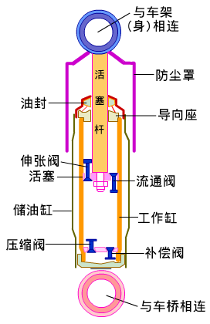
双向筒式减振器
Double action telescopic shock absorber
定义：在压缩和伸张两行程内均能起减振作用的减振器。
Definition：A shock absorber that can reduce vibration at compression stroke and extension stroke.
减振器由活塞杆、活塞、储油缸筒、工作缸筒、伸张阀、压缩阀、补偿阀、流通阀、导向座、防尘罩等组成。
Shock absorber consists of piston rod, piston , oil storage cylinder , working cylinder, rebound valve, compression valve, compensating valve, flow valve, guide holder, dust cover and so on.

Slide 19
双向筒式减振器
Double action telescopic shock absorber
伸张阀和压缩阀分别是卸载阀，弹簧较强，预紧力大，只有当油压升高到一定高度时，才能开启，而当油压降低到一定程度时，阀将自行关闭。Rebound valve and compression valve are unloading valves. The spring is stronger and the preload is big. Only the oil pressure rises to a certain level can they open. And when the oil pressure reduces to a certain level the valves close automatically.
补偿阀和流通阀是单向阀，弹簧较弱，当油压作用力与弹簧同向时，阀处于关闭状态，而当油压作用力与弹簧力反向时，很小的油压便能将阀开启。Compensating valve and flow valve are one-way valves. The spring is weak. When the oil pressure force is the same direction as spring force，the valves close. When the oil pressure force is opposite direction to spring force, just a small oil pressure can open the valves.
其作用是分别在拉伸和压缩行程中补偿油液，避免上下腔中出现真空。The function is compensation the oil in extension stroke and compression stroke to avoid appearing vacuum in the upper and under lumens.

Slide 20
双向筒式减振器的工作过程
The working process of double action telescopic shock absorber
连杆和活塞一起向下运动 Connecting rod moves downwards with the piston
压缩行程
Compression stroke
工作缸下腔油液压力增高 The oil pressure of working cylinder’s under lumen increases
伸张阀和补偿阀关闭 Rebound valve and compensating valve close
下腔的高压打开流通阀 The high pressure of the under lumen opens the flow valve
液体自压缩阀的常通孔流出到储油缸筒 The liquid outflows from the normal open hole of the compression to oil storage cylinder
阻尼力逐渐增大 The damping force increases gradually
当活塞运动速度很快，下腔油压很大，克服压缩阀压紧弹簧，压缩阀完全打开，阻尼力不再增加，起到卸载作用。When the velocity of piston is very quick, the oil pressure of under lumen is high. It overcomes the retainer spring of the compression and the compression valve open completely. The damping force doesn’t increase, so playing a role of unloading.

Slide 21
双向筒式减振器的工作过程
The working process of double action telescopic shock absorber
连杆和活塞一起向上运动 Connecting rod moves upwards with the piston
拉伸行程
Drawing stroke
工作缸上腔油液压力增高 The oil pressure of working cylinder’s upper lumen increases.
流通阀和压缩阀关闭 The flow valve and compression valve close.
油液自伸张阀上的常通孔流向下腔 The oil flows into under lumen through rebound valve’s normal open holes.
补偿阀打开，储油筒中油液流入到下腔 The compensating valve open, the oil in the oil reservoir casing flows into the under lumen.
阻尼力逐渐增大 The damping force increases gradually
当活塞运动速度很快，上腔油压很大，克服伸张阀的压紧弹簧，伸张阀完全打开，阻尼力不再增加，起到卸载作用。When the velocity of piston is very quick, the oil pressure of the upper lumen is high. It overcomes the retainer spring of the rebound valve and the rebound valve opens completely. Then the damping force doesn’t increase, so playing a role of unloading.

Slide 22
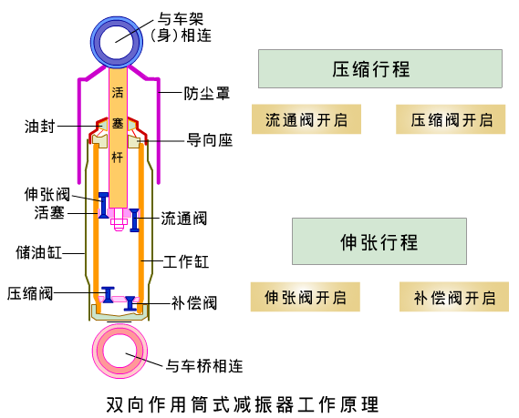
双向筒式减振器的工作过程
The working process of double action telescopic shock absorber

Slide 23
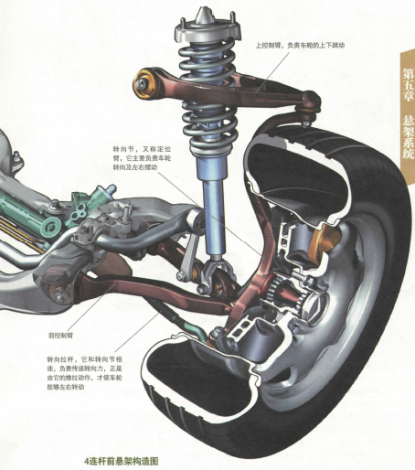
第三节 弹性元件
Section 3 Elastic component

Slide 24
悬架所用的常用弹性元件
The commonly used elastic component of the suspension
钢板弹簧：组成的悬架结构简单，工作可靠，刚度大，适用于非独立悬架。
Leaf spring：The suspension installed is simple , working reliable, high stiffness. And it is suitable for independent suspension.
螺旋弹簧：制造工艺简单，不需要润滑，安装的纵向空间小，质量小，适用于独立悬架。
Coil spring：The manufacture process is simple, and it needn’t lubrication. The longitudinal space of installment and the quality are small . It is suitable for independent suspension.
扭杆弹簧：单位质量的储能高，结构简单，不需要润滑，方便布置。
Torsion rod spring：The stored energy of unit mass is high. The structure is simple and it needn’t lubrication. And it is convenient to arrangement.
空气弹簧：统称为气体弹簧，具有变刚度特性，可调整车身高度。可提高汽车的舒适性和平顺性。应用于高级大巴和高级轿车。
Air spring： Collectively called gas spring. It has the characteristics of variable stiffness. It can adjust the height of car body and increase the comfort and ride performance of the vehicle. It is used in senior bus and limousine.
橡胶弹簧：单位储能高，有阻尼特性、隔振，用于缓冲块。
Rubber spring： The stored energy of unit mass is high. It has damping force characteristics and vibration isolation. It is used as bumper block.

Slide 25
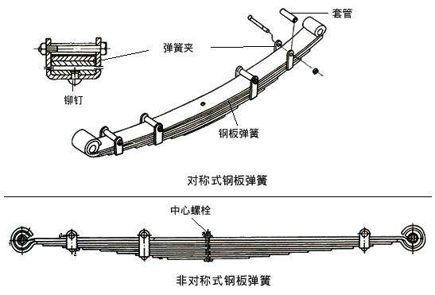
钢板弹簧
Leaf spring
由若干片等宽但不等长的合金弹簧片组合而成的近似等强度的弹性梁，多数情况下由多片弹簧组成 。Approximately same strength elastic beam which is combined by several alloy spring pieces with same width but different length. It contains several leaves of spring in most cases.

Slide 26
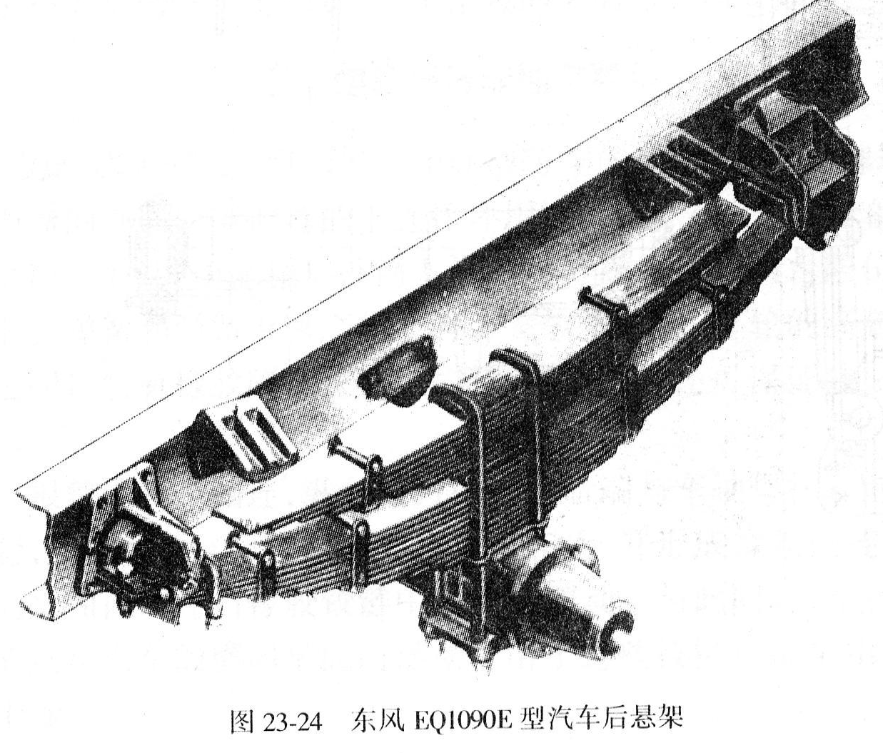
钢板弹簧
Leaf spring
钢板弹簧的第一片最长，称为主片。主片的两端弯成卷耳，内装青铜或塑料、橡胶、粉末冶金制成的衬套，并通过弹簧销与车架或者吊耳作铰链连接。The first leaf of leaf spring is longest, and we call it main leaf. The two ends of main leaf is bended as spring eyes. Linings made up from bronze or metallurgy consisting of plastics, rubber and powder are installed in it. And it uses hinge joint to link with frame or spring eye through spring pin .
钢板弹簧的中部一般用U形螺栓固定在车桥上。The middle part of leaf spring is fixed on axle using U-bolts.
中心螺栓的作用是连接各弹簧片，保证各片的装配位置。The function of center bolt is connecting each leaf spring and ensuring the assembly position of each leaf.
按其距两耳的距离分为对称式钢板弹簧和非对称钢板弹簧。According to the distance of the two spring eyes we can divide it into symmetric leaf spring and non-symmetric leaf spring.

Slide 27
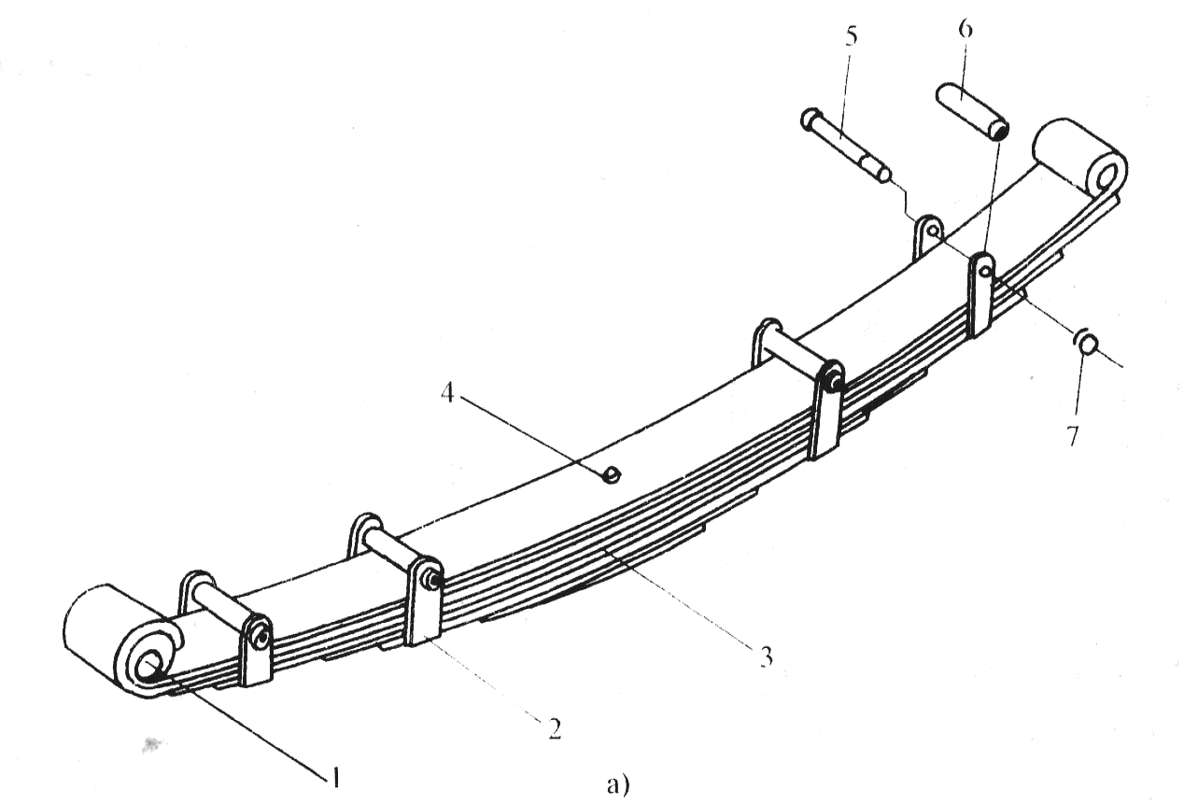
钢板弹簧
Leaf spring
钢板弹簧在载荷作用下变形时，各片之间相对滑动而产生摩擦，促进车架的振动衰减。When the leaf spring deforms under load. The relative sliding between each leafs cause friction and promote the vibration attenuation of frame.
但这种干摩擦也降低了悬架的缓和冲击作用，加速磨损的问题，一般需要装配时各片之间涂上较稠的润滑剂，并定期的保养。But this kind of dry friction decreases the impact alleviating function of suspension and quickens wear. So generally we need wiping thicker lubricant between each leafs when we assemble it. And scheduled maintenance is needed also.
钢板弹簧本身能起到导向的作用，同时各片之间的摩擦还起到一定的减振作用。一般在弹簧片之间夹入塑料垫片，以产生定值的摩擦力和消除噪音。Leaf spring itself can play the role of guide. In the same time, the friction between each leafs have the function of damping to a certain extent. Generally we sandwich plastic resin chock between each leafs to produce certain friction and eliminate noise.

Slide 28
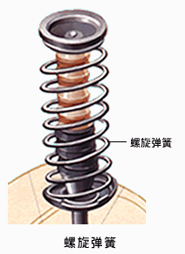
螺旋弹簧
Coil spring
螺旋弹簧由弹簧钢棒料卷制而成。Coil spring is coiled by spring steel barstock.
优点：无须润滑、不怕泥污、纵向布置空间较小、质量小。Advantage：It needn’t lubrication and does not afraid of dirt. The vertical arrangement space is lesser and the quality is small.
缺点：无减振作用，只能承受铅垂载荷，需装设导向机构。Disadvantage：It does not have the effect of damping and can only bears vertical load. So we need installing guide mechanism.

Slide 29
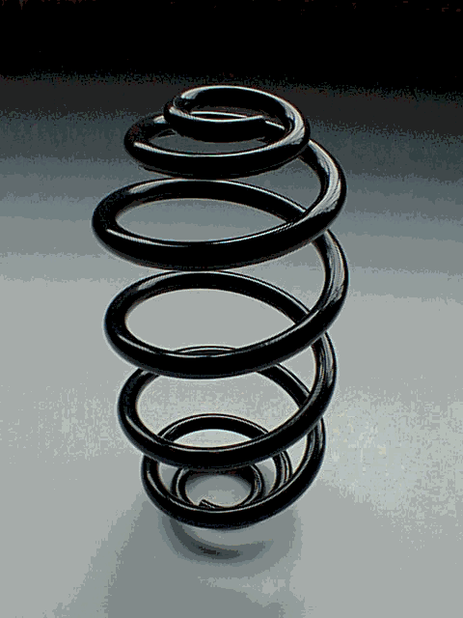
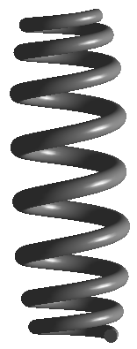
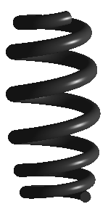
螺旋弹簧 Coil spring
目前汽车上采用的通过变钢丝直径、螺距、弹簧直径的非线性螺旋弹簧，以获得更好的平顺性。
Nowadays the vehicle adopts non-linear feature coil spring with variable diameter of steel wire, variable coil pitch or variable diameter of spring to acquire better riding comfort.
Notes:
Chapter 22 Suspension

Slide 30
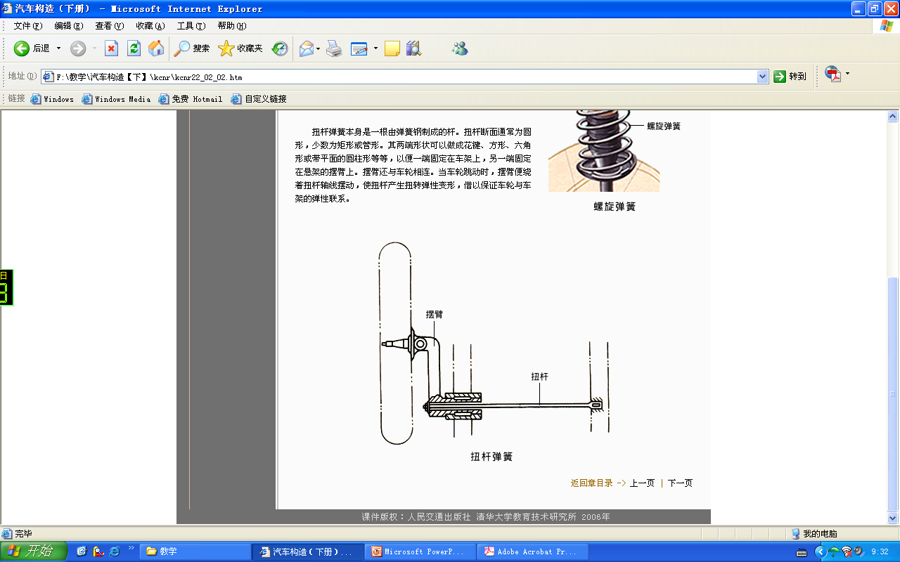
扭杆弹簧 Torsion rod spring
扭杆弹簧本身是一根由弹簧钢制成的杆。
Torsion rod spring itself is a pole made from spring steel.
扭杆断面通常为圆形，少数为矩形或管形。
Usually the section of torsion rod is round. Minority of them are rectangle or tubular.
两端形状可以做成花键、方形、六角形或带平面的圆柱形等等，以便一端固定在车架上，另一端固定在悬架的摆臂。
The shape of two ends can make into spline, square, hexagon or cylinder with plane, and so on. So that one end can be fixed on frame and the other end fixed on the swing arm of suspension.

Slide 31
扭杆弹簧 Torsion rod spring
摆臂与车轮相连，因此当车轮跳动时，摆臂便绕着扭杆轴线摆动，使扭杆产生扭转弹性变形，借以保证车轮与车架的弹性联系。
The swing arm links with wheel. So when the wheel hops, the swing arm swings around the axis of the torsion rod. And the torsion rod engenders torsional elastic deformation to ensure the elastic relationship between wheel and frame.
材料：铬钒合金弹簧钢，表面涂环氧树脂和防锈漆。
Material: Chrome-vanadium alloy spring steel. Epoxy resin and antirust paint is spread on the surface.

Slide 32
扭杆弹簧 Torsion rod spring
The characteristics of torsion rod spring
加工时可以预先产生内应力;
Internal stress can be prepossessed when machining
储能能力比钢板弹簧和螺旋弹簧都大，质量轻；
The energy storage capacity is larger than leaf spring and coil spring. And it quality is light
结构比较简单，不需要润滑；
The structure is simple. And it needn’t lubrication
左右扭杆弹簧不能互换.
The left and right torsion rod springs can’t interchange
布置方便（ Easy arrangement ）;
扭杆过短将影响舒适性以及平顺性
If the torsion bar is too short, the comfort and smooth will be influenced.

Slide 33
气体弹簧 Gas spring
气体弹簧是在一个密封的容器中充入压缩气体，利用气体可压缩性实现弹簧的作用。
Gas spring is filling compressed gas in a sealed container. And using the compressibility of gas to realize the function of spring.
气体弹簧的特点是，作用在弹簧上的载荷增加时，容器中气压升高，弹簧刚度增大；反之，当载荷减小时，气压下降，刚度减小。
The characteristics of gas spring is the load added on spring increases, the gas pressure in container rises and the spring stiffness increases. On the contrary, when the load decreases, the gas pressure drops and the spring stiffness decreases.
气体弹簧具有理想的变刚度特性。
Gas spring has an ideal variable stiffness characteristic.
气体弹簧有空气弹簧和油气弹簧两种。
There are two kinds of gas spring: air spring and hydro-pneumatic spring.
空气弹簧又可分为囊式空气弹簧和膜式空气弹簧。
And air spring can divided as bellow type air spring and diaphragm type air spring

Slide 34
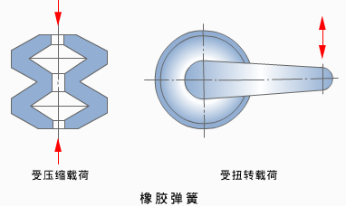
Rubber spring（橡胶弹簧）
橡胶弹簧利用橡胶本身的弹性起弹性元件的作用；
Rubber spring utilizing the elasticity of rubber acts as elastic component;
它可以承受压缩载荷和扭转载荷，由于橡胶的内摩擦较大，橡胶弹簧还具有一定的减振能力；
It can bear compression load and torsion load. Because the internal friction of rubber is high, so it has vibration attenuation ability.
橡胶弹簧多用作悬架的副簧和缓冲块。
Rubber spring is often used as auxiliary spring and bumper block of suspension.

Slide 35
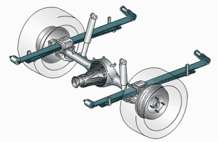
第四节 非独立悬架 rigid axle suspension
Notes:
Chapter 22 Suspension

Slide 36
非独立悬架的特点及分类
The characteristics and classification of rigid axle suspension
非独立悬架的特点：结构简单，工作可靠，采用钢板弹簧的非独立悬架中，省却了导向结构，方便布置。
The characteristics of rigid axle suspension: Simple structure, working reliably. The rigid axle suspension adopts leaf spring dispenses with guide structure and is convenient to arrangement.
因此广泛应用于货车的前、后悬架和轿车的后悬架。
So it is widely used in the front and rear suspension of truck and the rear suspension of car.

Slide 37
非独立悬架的特点及分类
The characteristics and classification of rigid axle suspension
非独立悬架的分类
The classification of rigid axle suspension
钢板弹簧非独立悬架 Leaf spring rigid axle suspension
螺旋弹簧非独立悬架 Coil spring rigid axle suspension
空气弹簧非独立悬架 Gas spring rigid axle suspension
油气弹簧非独立悬架 Hydro-pneumatic spring rigid axle suspension

Slide 38
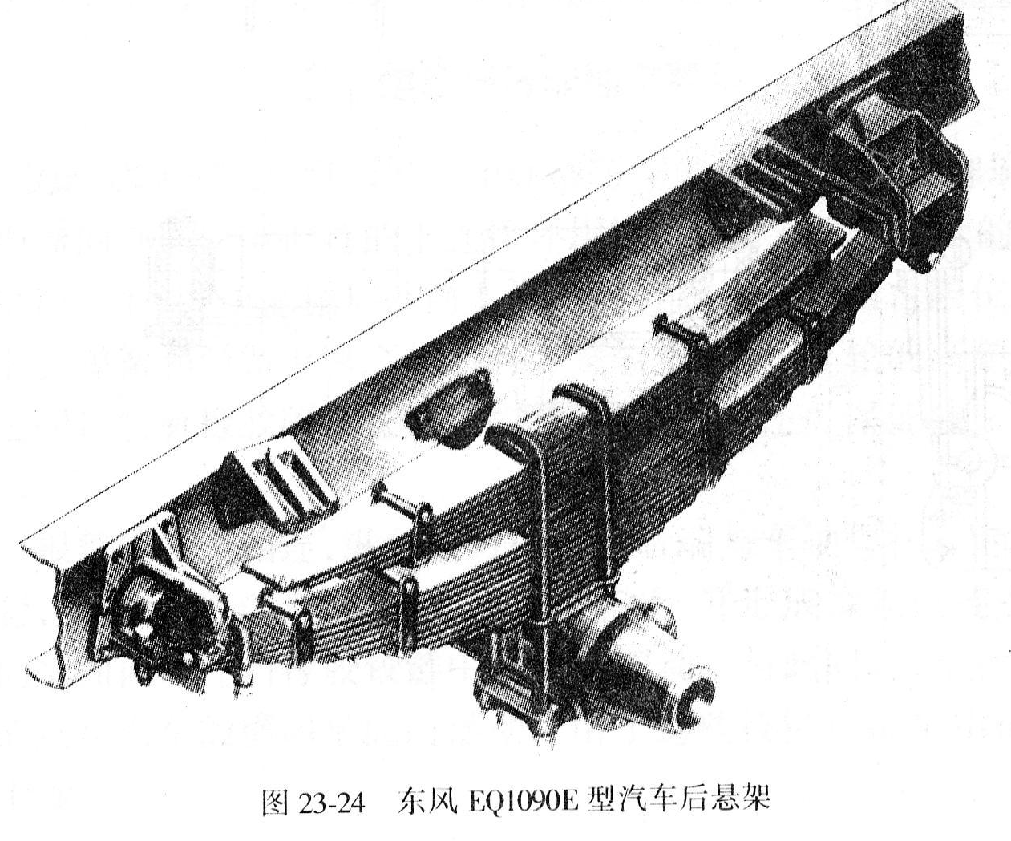
采用主副簧结构的钢板弹簧悬架
The leaf spring suspension using main and auxiliary springs
目的：通过主副簧先后起作用，得到变刚度特性提高汽车平顺性。
Purpose：Via the main and auxiliary springs playing role successively to achieve the variable stiffness characteristic and improve the riding comfort.
有副簧在上和主簧在下两种结构。
There are auxiliary spring above and auxiliary spring underneath two types.

Slide 39
采用主副簧结构的钢板弹簧悬架
The leaf spring suspension using main and auxiliary springs
F
刚度突变，不利于汽车平顺性。
Abrupt change in stiffness，harmful to vehicle ride
S
副簧在上的刚度特性
The stiffness characteristics upper auxiliary leaf spring

Slide 40
采用主副簧结构的钢板弹簧悬架
The leaf spring suspension using main and auxiliary springs
F
副簧逐渐起作用，具有刚度渐变的特点，有利于汽车平顺性。
Auxiliary leaf spring gradually work, gradually changing in stiffness, which is good for vehicle ride.
S
副簧在下的刚度特性
The stiffness characteristics
of lower auxiliary leaf spring

Slide 41
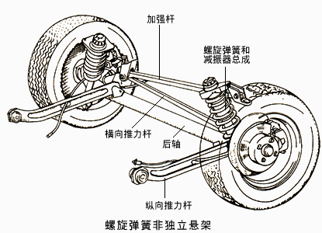
螺旋弹簧非独立悬架
Coil spring rigid axles suspension
一般只用作轿车的后悬架，具有纵向布置方便，便于维护和保养的特点。
Generally used only for the car‘s rear suspension which is convenience for longitudinal arrangement and easy for maintenance.
由于螺旋弹簧只能承受较小侧向力，因此需要加装横向推力杆和纵向推力杆。
As coil spring can only afford a smaller lateral force , suspension require the installation of horizontal thrust rod and vertical thrust rod .
加强杆用以加强横向推力杆安装强度,将横向载荷均匀分布于车身左右。
Reinforcing rods to strengthen the horizontal thrust rod mounting strength , the lateral load is evenly distributed around the body .

Slide 42
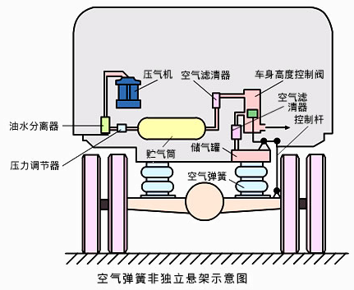
空气弹簧非独立悬架
Air springs rigid axles suspension
空气弹簧非独立悬架主要由囊式空气弹簧、压气机、车身高度调节控制阀、控制杆等组成。
Air spring rigid axles suspension consists of air springs, compressor, body height adjustment control valves, control rod.
采用空气弹簧悬架容易实现车身高度的自动调节。
Easy to implement the automatic adjustment of ride height with air spring suspension .
空气弹簧只能传递垂直力，故其纵向力和横向力以及其力矩也必须由纵向推力杆和横向推力杆来传递。
The air spring can only transfer the vertical force, so longitudinal force and lateral force , and torque must be transferred by the longitudinal rod and horizontal rod.

Slide 43
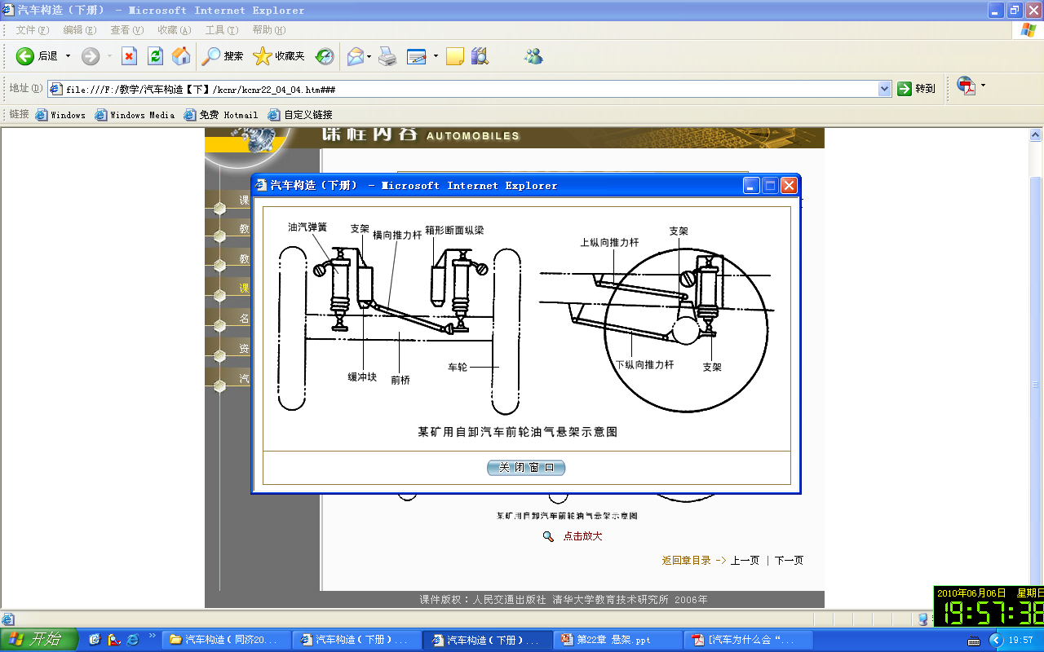
油气弹簧非独立悬架
Hydro-Pneumatic Spring rigid axles suspension
油气弹簧非独立悬架主要由油气弹簧（兼起减振器作用）、横向推力杆、纵向推力杆等组成，推力杆起导向和传力的作用。
Hydro-pneumatic spring rigid axles suspension consists of hydro-pneumatic spring (as the damper)、horizontal push rod、 longitudinal push rod. The function of push rod is guiding and force transfer.
油气弹簧具有变刚度特性，被广泛地采用在大型矿用自卸车上。
The hydro-pneumatic spring has variable stiffness characteristics , is widely used in large mining trucks .

Slide 44
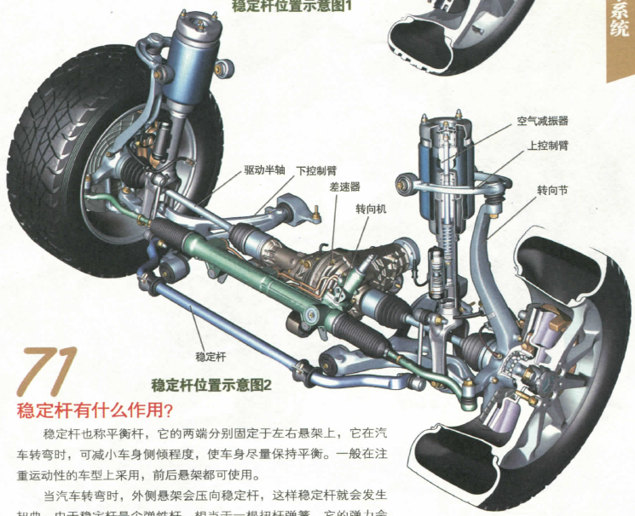
第五节 独立悬架
Chapter 5 Independent suspension

Slide 45
独立悬架的特点
Independent suspension characteristics
结构特点：两侧车轮独立地与车架或车身弹性连接。
Structural features : both sides of the wheel connected to the frame or body flexibly.
独立悬架的优点
The advantages of independent suspension
两侧车轮可以单独跳动，可减少车身振动，减少转向轮偏摆；
Two wheels can be move independently, reducing the vibration of the body and the steering wheel runout ;
降低非簧载质量，提高平均车速；
Reduce unsprung mass, increase the average speed ;

Slide 46
独立悬架的特点
Independent suspension characteristics
独立悬架的优点
The advantages of independent suspension
采用断开式车桥，降低汽车重心，提高行驶稳定性；
Using the divided axle can lower the vehicle center of gravity and improve driving stability;
提供了较大的车轮跳动空间，因此减小悬架刚度，降低汽车偏频，提高平顺性。
Provide a larger wheel runout space and therefore to reduce the suspension stiffness , reducing the offset frequency of the vehicle to improve ride comfort.
独立悬架的缺点：结构复杂、制造成本高，维护不便，车轮引起轮矩变化，加剧轮胎磨损。
The disadvantage of the independent suspension：The complex structure and high manufacturing costs, and maintenance inconvenience , the wheel causes track change , increased tire wear.

Slide 47
独立悬架的分类
Independent suspension classification
车轮在横向平面内摆动的悬架（横臂式独立悬架）
The suspension that the wheel swinging in the transverse plane（Transverse Arm Independent Suspension）
车轮在纵向平面内摆动的悬架（纵臂式独立悬架）
The suspension that the wheel swing in the longitudinal plane（Trailing Arm Independent Suspension）
车轮沿主销移动的悬架（烛式和麦弗逊式独立悬架）
The suspension that wheels moving along kingpin （ Sliding pillar suspension & McPherson strut suspension）
车轮在斜向平面侧摆动的悬架（单斜臂式独立悬架）
The suspension that wheels swinging on the oblique plane side. （ Semi-trailing arm suspension）

Slide 48
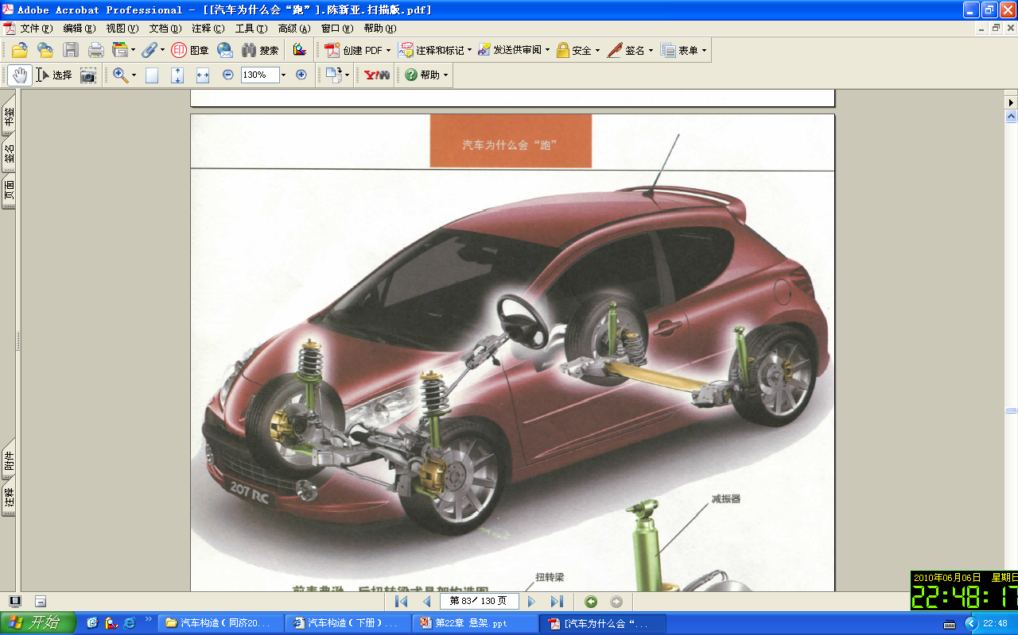
独立悬架的应用
Application of independent suspension
独立悬架采用的弹性元件多是螺旋弹簧和扭杆弹簧。
Elastic elements using in independent suspension are coil springs and torsion bar springs .
独立悬架一般应用于各种车辆特别是轿车的前悬架，轿车的后悬架一般采用非独立悬架或者复合式悬架（半独立悬架）。
The independent suspension is generally used in a variety of vehicles , especially the front suspension, rear suspension of the car is generally non- independent suspension or composite suspension ( semi - independent suspension ) .

Slide 49
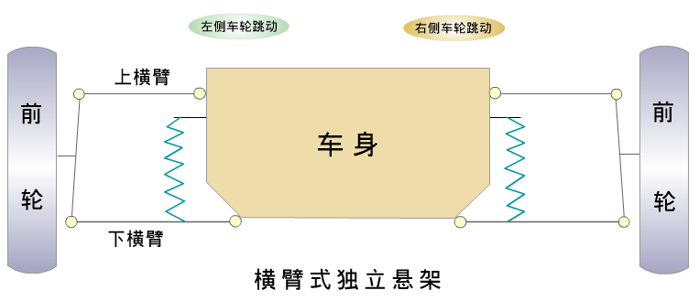
横臂式独立悬架
Swing Axle Independent Suspension
特点：车轮在汽车的横向平面内跳动。
Features: wheels moving in the transverse plane of the car.

Slide 50
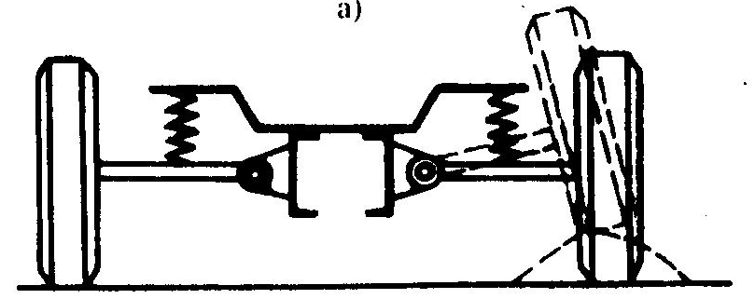
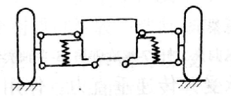
横臂式独立悬架
Swing Axle Independent Suspension
根据横臂的数量可分为单横臂独立悬架和双横臂独立悬架。
According to the wishbone number can be divided into swinging arm independent suspension and double wishbone independent suspension .
单横臂式
swinging arm independent suspension
双横臂式
double wishbone independent suspension

Slide 51
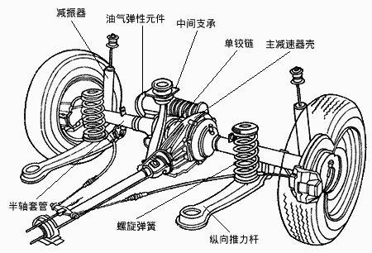
单横臂式独立悬架
Swinging Arm Independent Suspension
特点:当车轮跳动时将改变轮距，用于转向轮时，引起主销内倾角和车轮外倾发生变化。
Features: will change track when the wheel runout, for the steering wheel ,wheel runout will cause the kingpin inclination and wheel camber change .
应用于车速不高的重型越野车辆。
Applied to low speed heavy-duty off-road vehicle .
戴姆勒-奔驰轿车后驱动桥用单横臂悬架。
Daimler - Mercedes-Benz with a swing arm independent suspension for rear drive axle.

Slide 52
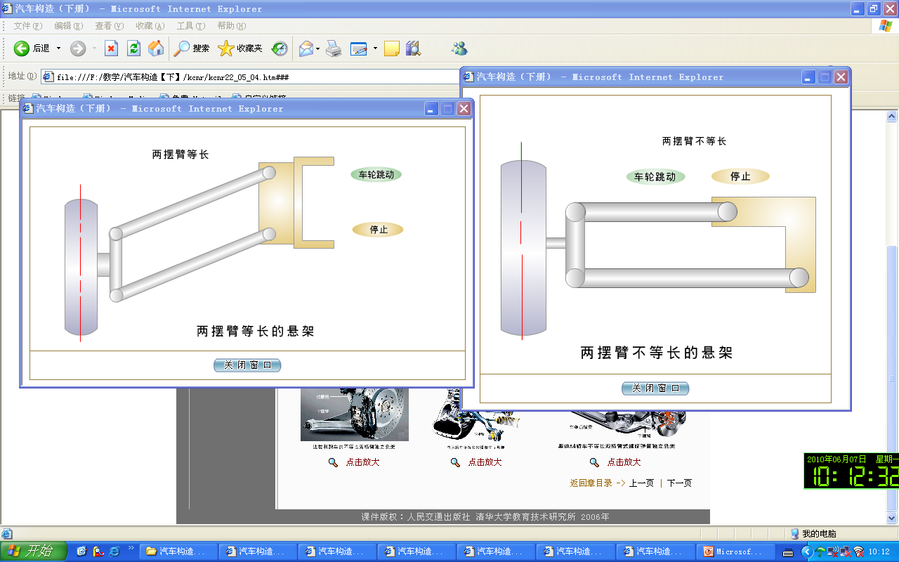
双横臂式独立悬架
Double Wishbone Independent Suspension
等臂式双横臂悬架：车轮跳动时车轮不倾斜但轮距变化较大。
Equal-arm double wishbone suspension : wheel does not tilt but larger track changing .
不等臂式双横臂悬架：车轮跳动时车轮倾斜但轮距变化可以较小。
Short long arms double wishbone suspension：wheel tilts with smaller track changing.
两摆臂不等长的双横臂独立悬架广泛应用于中高级轿车。
Short long arms double wishbone independent suspension is widely used in high-class cars .

Slide 53
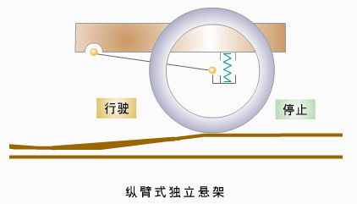
纵臂式独立悬架
Trailing link independent suspension

Slide 54
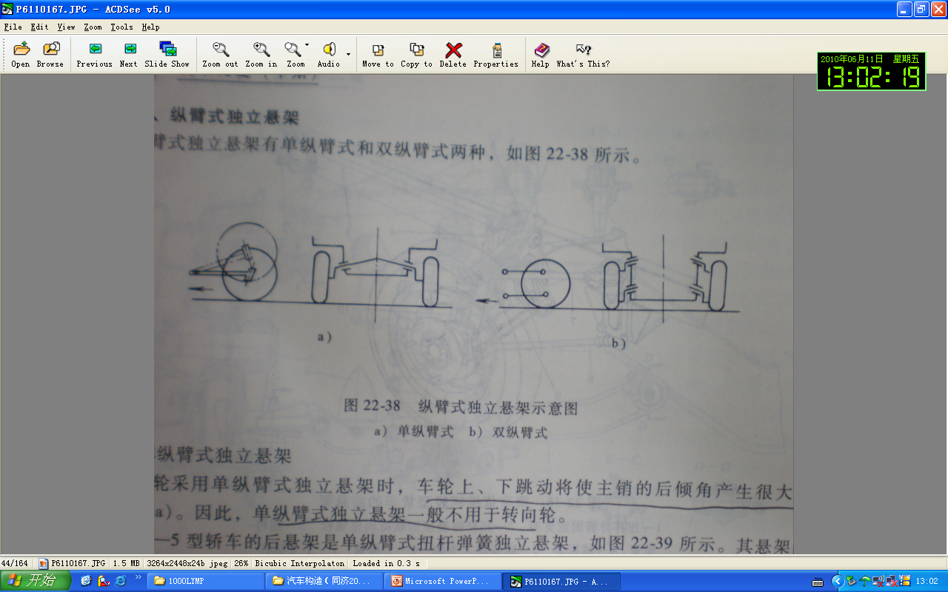
纵臂式独立悬架
Trailing link independent suspension
根据采用的纵臂数目可分为单纵臂独立悬架和双纵臂独立悬架。
According to the number of longitudinal arm can be divided to single trailing arm suspension and double trailing arm independent suspension.
根据采用的弹性元件可分为螺旋弹簧纵臂式独立悬架和扭杆弹簧纵臂式独立悬架。
According to the elastic element can be divided to trailing arm coil spring independent suspension and trailing arm torsion bar spring independent suspension.
车轮上下跳动时，单纵臂式独立悬架将引起较大的主销后倾角变化，因此多用于后悬架。
While wheel moving, single trailing arm independent suspension will cause larger caster angle changes, so commonly used in the rear suspension .

Slide 55
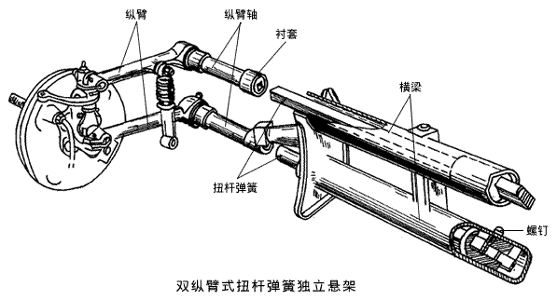
双纵臂式独立悬架
Double trailing arm independent suspension
结构特点：两个纵臂长度一般做成相等，形成平行四连杆机构。车轮上下跳动时，主销的后倾角保持不变，适用于转向轮。
Structural features : length of double trailing arm is generally made equal to form a parallel four-bar linkage . While the wheel jumping up and down ,the kingpin caster angle remains the same, so it’s applies to the steering wheel .

Slide 56
车轮沿主销移动的独立悬架
Independent suspension that wheels moving along the kingpin axis
按主销轴线能否摆动
Can kingpin axis swing
车轮沿固定不动主销轴线移动的独立悬架；
Independent suspension that wheels moving along the stationary kingpin axis;
车轮沿摆动主销轴线移动的独立悬架；
Independent suspension that the wheels moving along the swing kingpin axis;
烛式独立悬架
Sliding pillar suspension
麦弗逊式独立悬架（滑柱连杆式悬架）
MacPherson independent suspension）

Slide 57
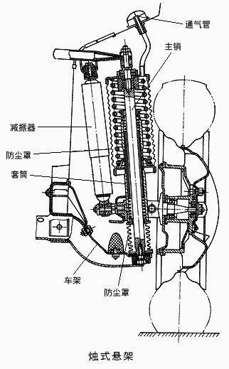
烛式独立悬架
Sliding pillar independent suspension
结构特点：车轮上的转向节沿着刚性地固定在车架上的主销上下移动。
Structural features: the steering knuckle on the wheels moves up and down along the kingpin secured rigidly on the frame.
优点：车轮转向时，前轮的定位参数不会发生变化，有利于转向操纵和行驶稳定性。
Advantages: when the wheel is steering, the positioning parameter of the front wheel does not change,which is conducive to the steering and driving stability .
缺点：车轮转向时，全部侧向力由主销和其外部的套管承受，增加了主销与套管的摩擦。
Disadvantages: when the wheel is steering, all lateral forces are borne by the kingpin and the external casing that increase the friction between kingpin and bushing .

Slide 58
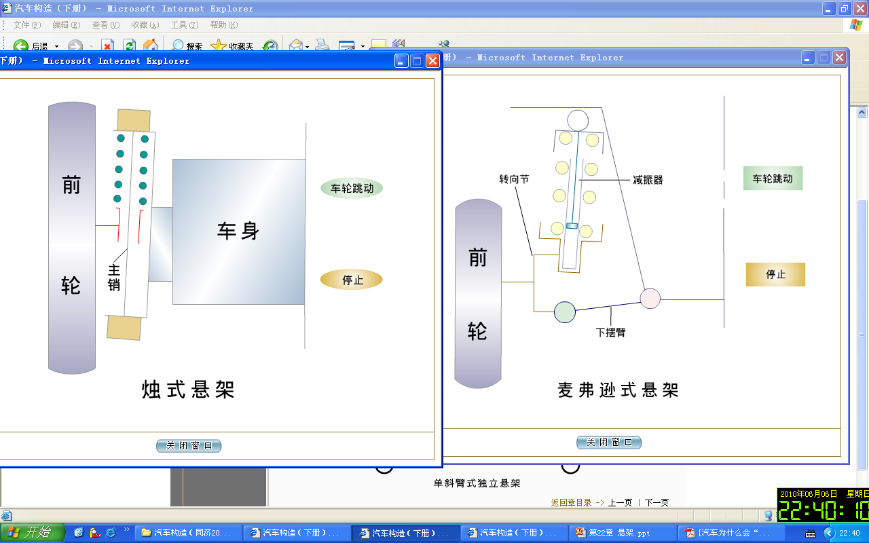
烛式独立悬架
Sliding pillar independent suspension

Slide 59
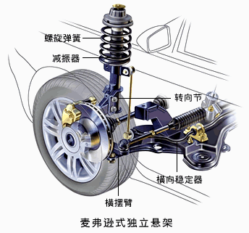
麦弗逊式（滑柱连杆式）独立悬架
McPherson strut independent suspension
结构特点：筒式减振器为滑动立柱，横摆臂的内端通过铰链与车身相连，外端通过球铰链与转向节相连，减振器的上端与车身相连，减振器的下端与转向节相连。
Structural features: the shock absorber is sliding uprights , cross the inner end of the swing arm via a hinge connected with the body , the outer end connected to the steering knuckle by a ball hinge, an upper end of the shock absorber connected with the body, the lower end of the shock absorber connected with the steering knuckle.

Slide 60
麦弗逊式（滑柱连杆式）独立悬架
McPherson strut independent suspension
烛式悬架的改进，用下摆臂克服了滑动立柱的受力状况，侧向力大部分由下摆臂承受。
An improvement of sliding pillar suspension: using the lower swing arm overcome the force status of the sliding uprights, most of the lateral force is borne by the lower swing arm .
属于无主销悬架，滑动立柱上支点和下摆臂外端的球铰中心构成主销轴线。
It belongs to no-kingpin suspension, sliding uprights fulcrum and the outer end center of the ball joints of the lower swing arm component of the kingpin axis .

Slide 61
麦弗逊式（滑柱连杆式）独立悬架
McPherson strut independent suspension

Slide 62
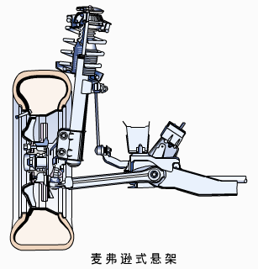
麦弗逊式（滑柱连杆式）独立悬架
McPherson strut independent suspension
优点：前轮内侧布置空间较大，方便前置前驱动布置。
Advantages: narrow package shape (more room for transverse mounted engines)
缺点：滑动立柱的摩擦和磨损较大。
Disadvantages: larger friction and wear of the sliding upright.
为减少减振器磨损,其轴线与弹簧的不重合。
To reduce damper wear , its axis and the spring do not overlap.
目前广泛应用于前驱轿车和部分轻型客车。
Widely used in a precursor cars and minibuses currently .

Slide 63
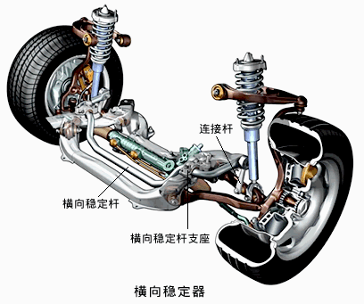
横向稳定器
Stabilizer Bar
原因：现代轿车的独立悬架较软，高速行驶转向时，车身很产生很大的横向倾斜和横向角振动。
The reason : modern car 's independent suspension is softer ,during high speed steering , the body will have a very great lateral tilt and horizontal angle vibration .
作用：在汽车高速行驶中转向时，通过横向稳定杆增强悬架系统的刚度，减小车身的横向倾斜和横向角振动。
Function: when vehicle is in a high-speed steering; stabilizer bar will enhance the stiffness of the suspension system to reduce lateral body tilt and lateral angle vibration.

Slide 64
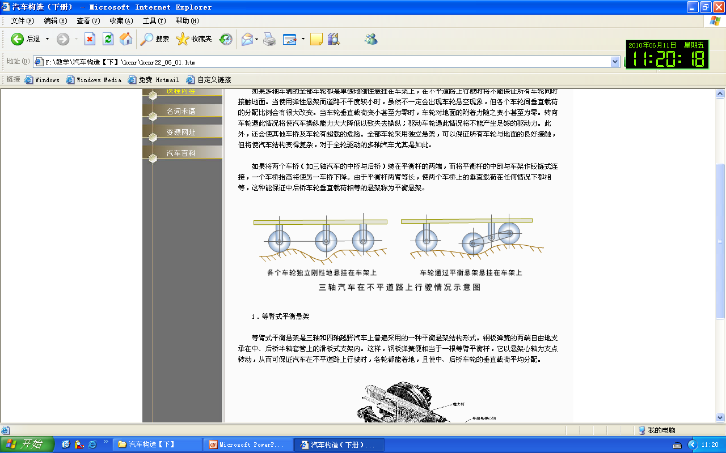
第六节 多轴汽车的平衡悬架
Chapter 6 the multi-axle vehicle 's balanced suspension
多轴车辆的全部车轮都是单独地刚性悬挂在车架上，在不平道路上行驶时将不能保证所有车轮同时接触地面。
All the wheels of the multi-axle vehicle are hanging on the frame separately and rigidly so that it will not be able to guarantee that all the wheels touch the ground at the same time when driving on rough roads.

Slide 65
第六节 多轴汽车的平衡悬架
Chapter 6 the multi-axle vehicle 's balanced suspension
当使用弹性悬架而道路不平度较小时，虽然不一定会出现车轮悬空现象，但各个车轮间垂直载荷的分配比例会有很大改变。
When using elastic suspension and road roughness is small, though the wheels are not off the ground, but the proportion of vertical load distribution on each wheel will change .
全部车轮采用独立悬架，可以保证所有车轮与地面的良好接触，但将使汽车结构变得复杂，特别是对全轮驱动的多轴汽车。
All-wheel independent suspension , a good contact between all of the wheels and the ground will be ensured, but it will make the car structure become complicated , especially the all-wheel drive multi-axle car.

Slide 66
平衡悬架
Balanced Suspension
如果将两个车桥（如三轴汽车的中桥与后桥）装在平衡杆的两端，而将平衡杆的中部与车架作铰链式连接，一个车桥抬高将使另一车桥下降。由于平衡杆两臂等长，使两个车桥上的垂直载荷在任何情况下都相等，这种能保证中后桥车轮垂直载荷相等的悬架称为平衡悬架。
If both axles (such as tri-axial vehicle bridge and the rear axle ) is mounted at both ends of the balance lever , while the middle of the balance rod hingedly connected to with the frame, an axle up will allow another vehicle bridge down. Since the balance lever arms is of equal length , so that the vertical load on the two axles are equal in any case , this can ensure that equal to the vertical load on the rear axle wheels of the suspension referred to as a balanced suspension .
平衡悬架一般可分为等臂式平衡悬架和摆臂式平衡悬架。
The balanced suspension generally can be divided into equal-arm balanced suspension and swing arm balanced suspension.

Slide 67
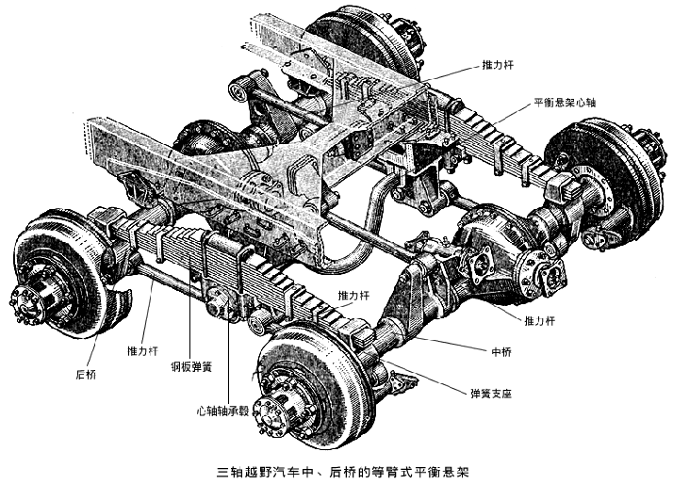
等臂式平衡悬架
Equal-arm balanced suspension
结构特点：钢板弹簧的两端自由地支承在中、后桥半轴套管上的滑板式支架内，相当于一根等臂平衡杆，它以悬架心轴为支点转动，从而可保证汽车在不平道路上行驶时，各轮都能着地，且使中、后桥车轮的垂直载荷平均分配。
Structural features：both ends of the leaf springs support the axle casing on the rear axle independently, the equivalent of equal-arm balance rod which roll around the suspension spindle fulcrum, so that can guarantee a car when traveling on rough roads , all the wheels can touch the ground , and evenly distributed vertical load on the wheels of the rear axle .

Slide 68
第七节 主动悬架和半主动悬架
Chapter 7 .Active suspension with semi - active suspension
悬架系统可根据汽车的运动状态、路面状况以及载荷等参数的变化，对悬架的刚度和阻尼进行动态地自适应调节，使悬架系统始终处于最佳减振状态的称为主动悬架系统。
According to the motion of the car , road conditions and load parameters, the stiffness and damping of the suspension can be dynamically adaptive adjusted so that the suspension system is always in the best damping state and this kind of suspension is known as active suspension systems.
包含动力源的主动悬架系统称为全主动悬架或有源主动悬架。
Active suspension system includes a power source called full- active suspension or active suspension .
不包含动力源的主动悬架系统称为半主动悬架或无源主动悬架。
Active suspension system without a power source called semi- active suspension.

Slide 69
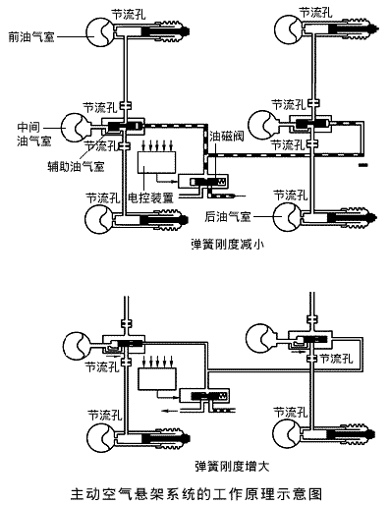
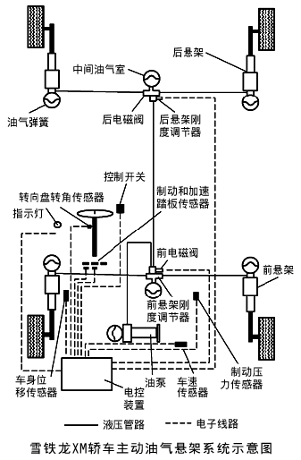
全主动悬架
Full active suspension
特点：能根据汽车的运动和路面状况，适时地调节悬架的刚度和阻尼。
Features: the suspension stiffness and damping can be adjusted timely according to the movement of the car and the road conditions.

Slide 70
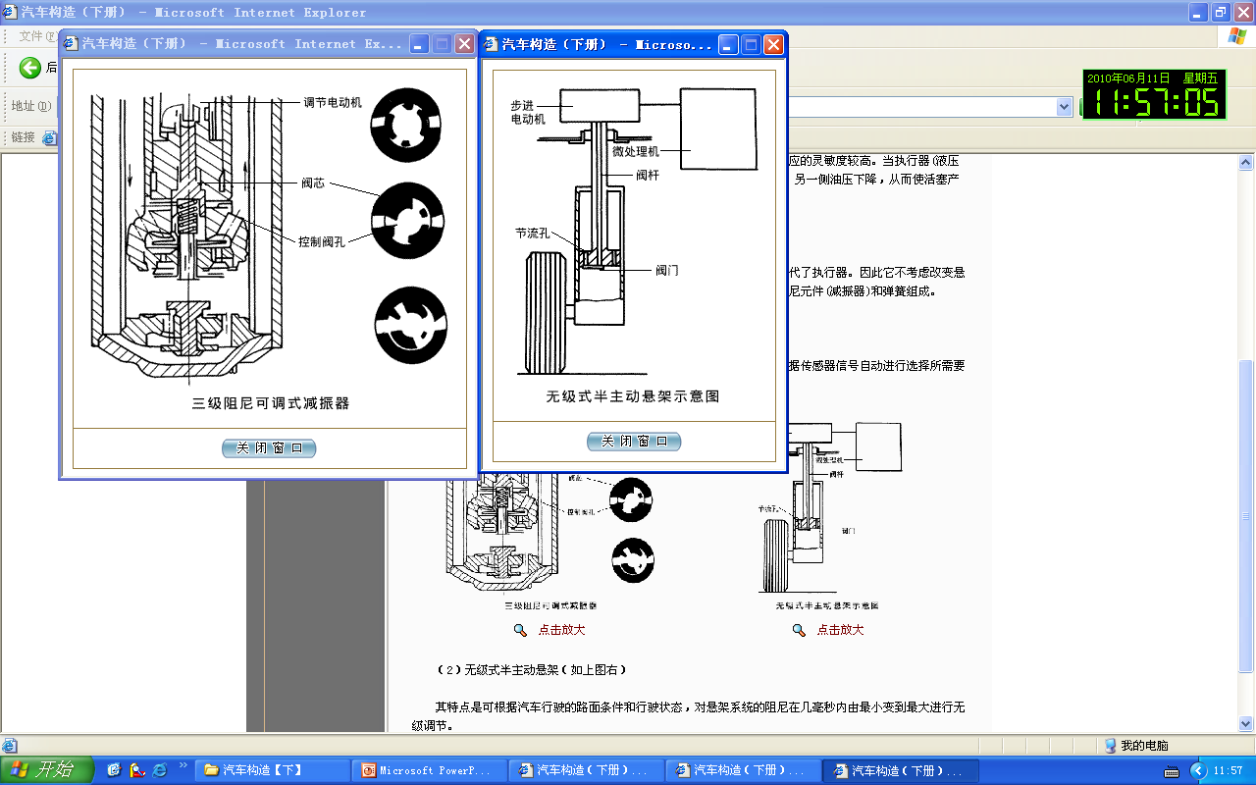
半主动悬架
Semi-active suspension
特点：不考虑悬架的刚度，而只考虑改变悬架的阻尼。
Features: Ignore the stiffness of the suspension , but only to consider adjustment of the suspension damping .

Slide 71
本章学习重点
The important points of this chapter
悬架的组成及功用；
The component and function of suspension;
双向作用筒式减振器的工作过程；
The working process of double action telescopic shock absorber；
常用弹性元件结构特点；
The structural characteristics of normal elastic component;
钢板弹簧非独立悬架的结构特点；
The structural characteristics of leaf spring independent suspension;
独立悬架的优缺点及结构类型；
The advantages and disadvantages of independent suspension;
几种独立悬架的机构特点；
The mechanical features of several independent suspension;
横向稳定器的作用。
The function of roll stabilizer.

Slide 72
作业
Homework
汽车上为什么设置悬架总成？一般它由哪几部分组成？
What’s the reason we install suspensions on cars? What is it combined of ?
什么是悬架的固有频率？它与哪些因素有关？
What is the inherent frequency of suspension? What factors is it related to?
双向作用筒式减振器的压缩阀、伸张阀、流通阀和补偿阀各起什么作用？压缩阀和伸张阀的弹性为什么较强？预紧力为什么较大？
What are the functions of double action telescopic shock absorber’s compression valve, rebound valve , flow valve and compensating valve ? Why the elasticities of compression valve and rebound valve are stronger? Why the preload is large?

Slide 73
作业
Homework
常用的弹性元件有哪几种？试比较它们的优缺点。
How many kind of common elastic component? Try to compare their advantages and disadvantages.
何为独立悬架、非独立悬架？钢板弹簧能否作为独立悬架的弹性元件？螺旋弹簧、扭杆弹簧以及气体弹簧等能否作为非独立悬架的弹性元件？
What are independent suspension and independent suspension? Can the leaf spring act as the elastic component of independent suspension ? Can coil spring, torsion rod spring and gas spring act as the elastic component of independent suspension?
钢板弹簧非独立悬架如何获得变刚度特性？
How the leaf spring independent suspension achieves variable stiffness characteristic?

